Slide 1
⭐️ 5B Food Vlogs ⭐️
Live Premiere 11/21/2025

Slide 2
Information on the grading
Sent on time? (script, video)
(4 phases of our project!) (15%)
Quality of your script?
(structure, content, words and phrases) (70%)
Presentation?
(editing, images/videos, visual storytelling) (15%)

Slide 3
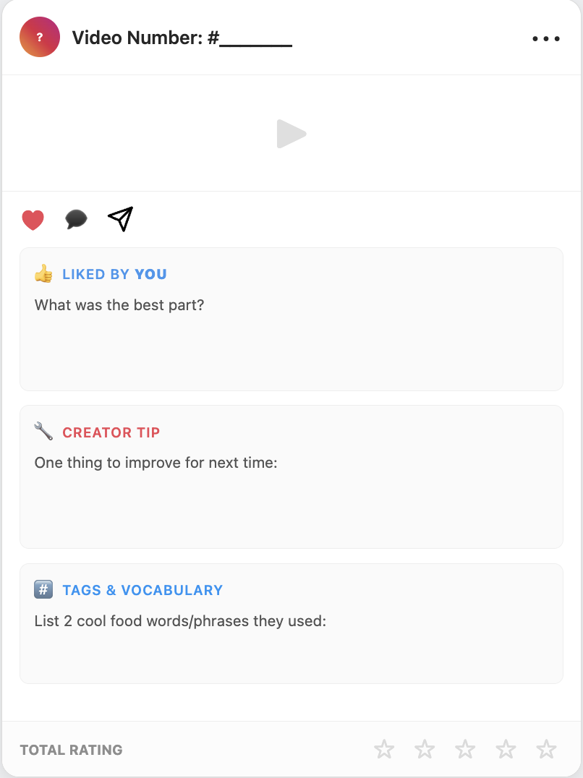
The “art” of giving feedback
Write the video number and fill out the feedback form for each clip!

Slide 4
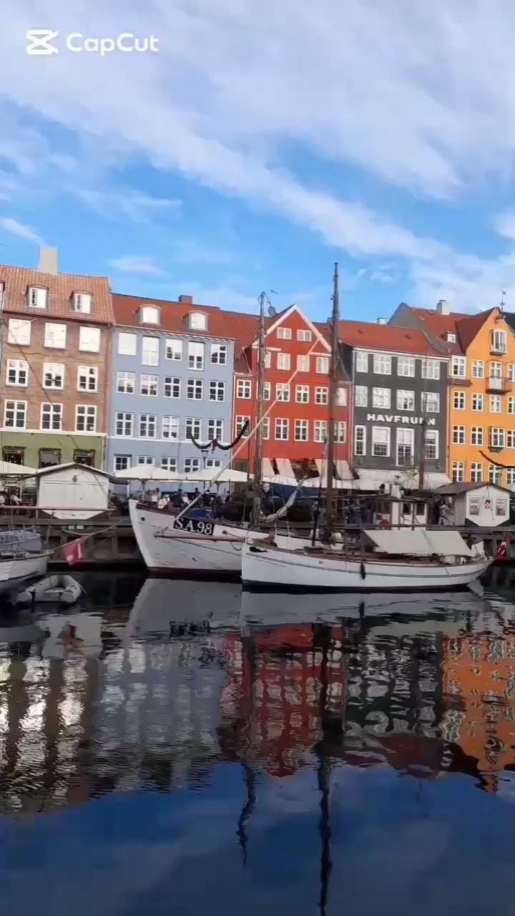
Video #1
Copenhagen

Slide 5
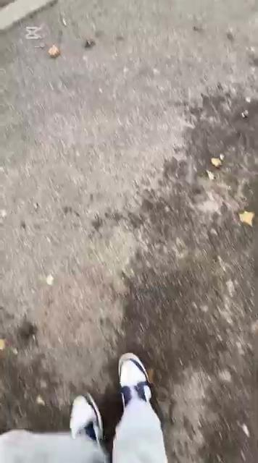
Video #2
Futterboden

Slide 6
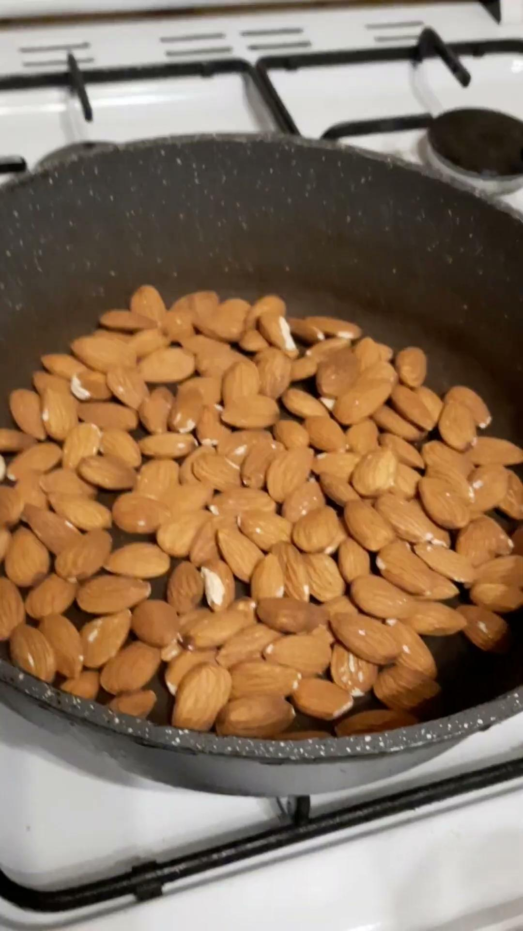
Video #3
Roasted
Almonds

Slide 7

Video #4
Pars

Slide 8

Video #5
Ramen Noodles

Slide 9
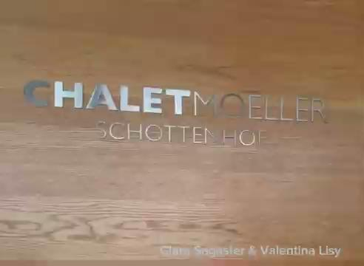
Video #6
Chalet
Moeller

Slide 10
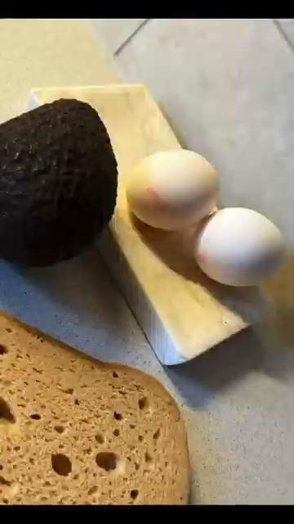
Video #7
Healthy
Breakfast

Slide 11
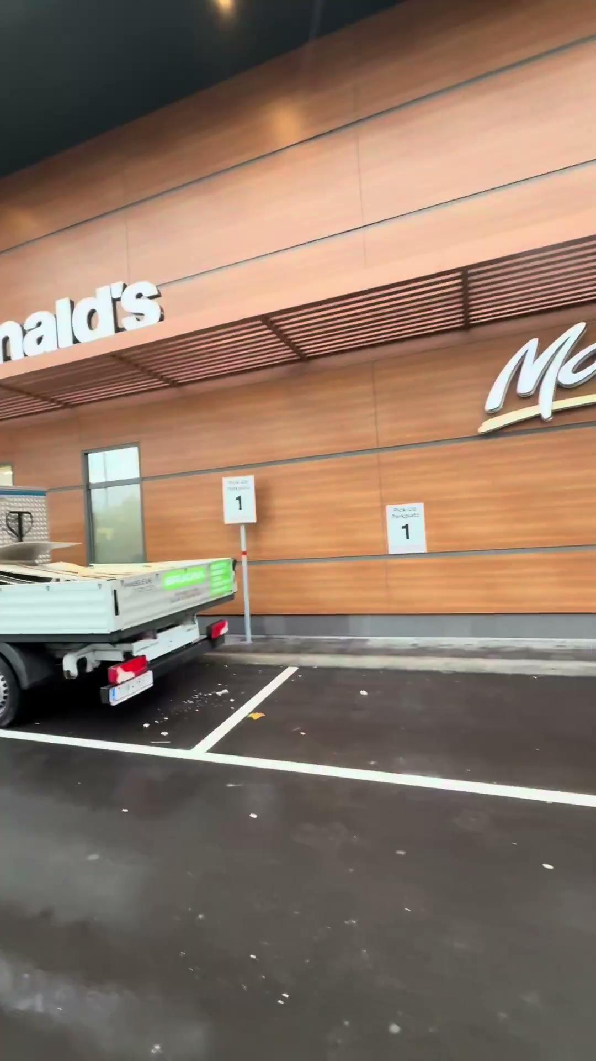
Video #8
McDonalds

Slide 12

Video #9
Italy

Slide 13
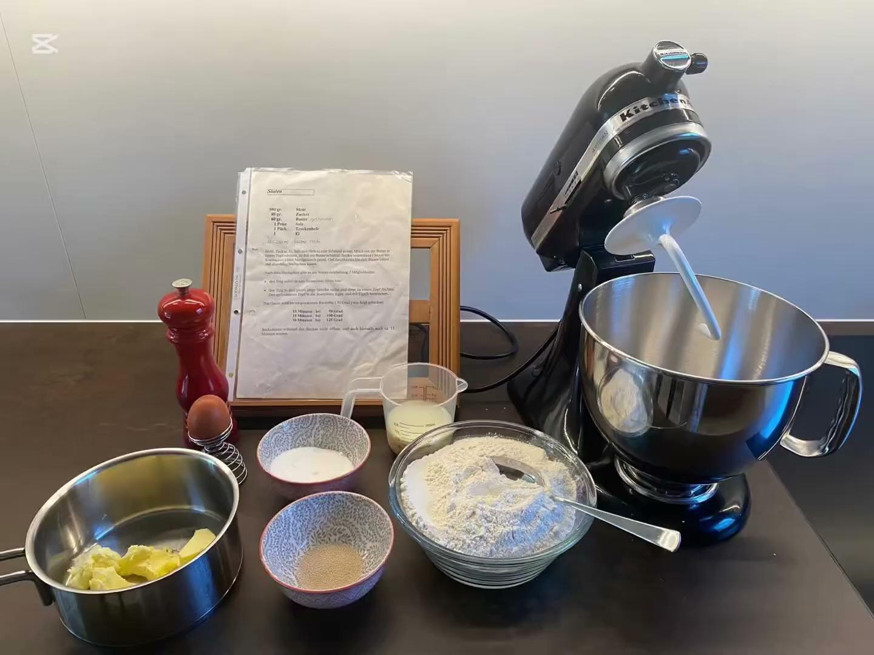
Video #10
Hefezopf

Slide 14
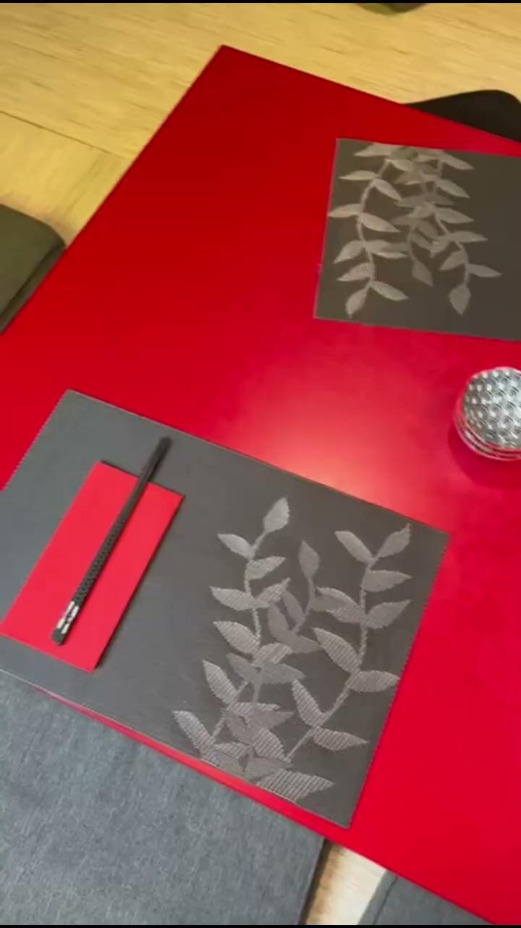
Video #11
Yume

Slide 15
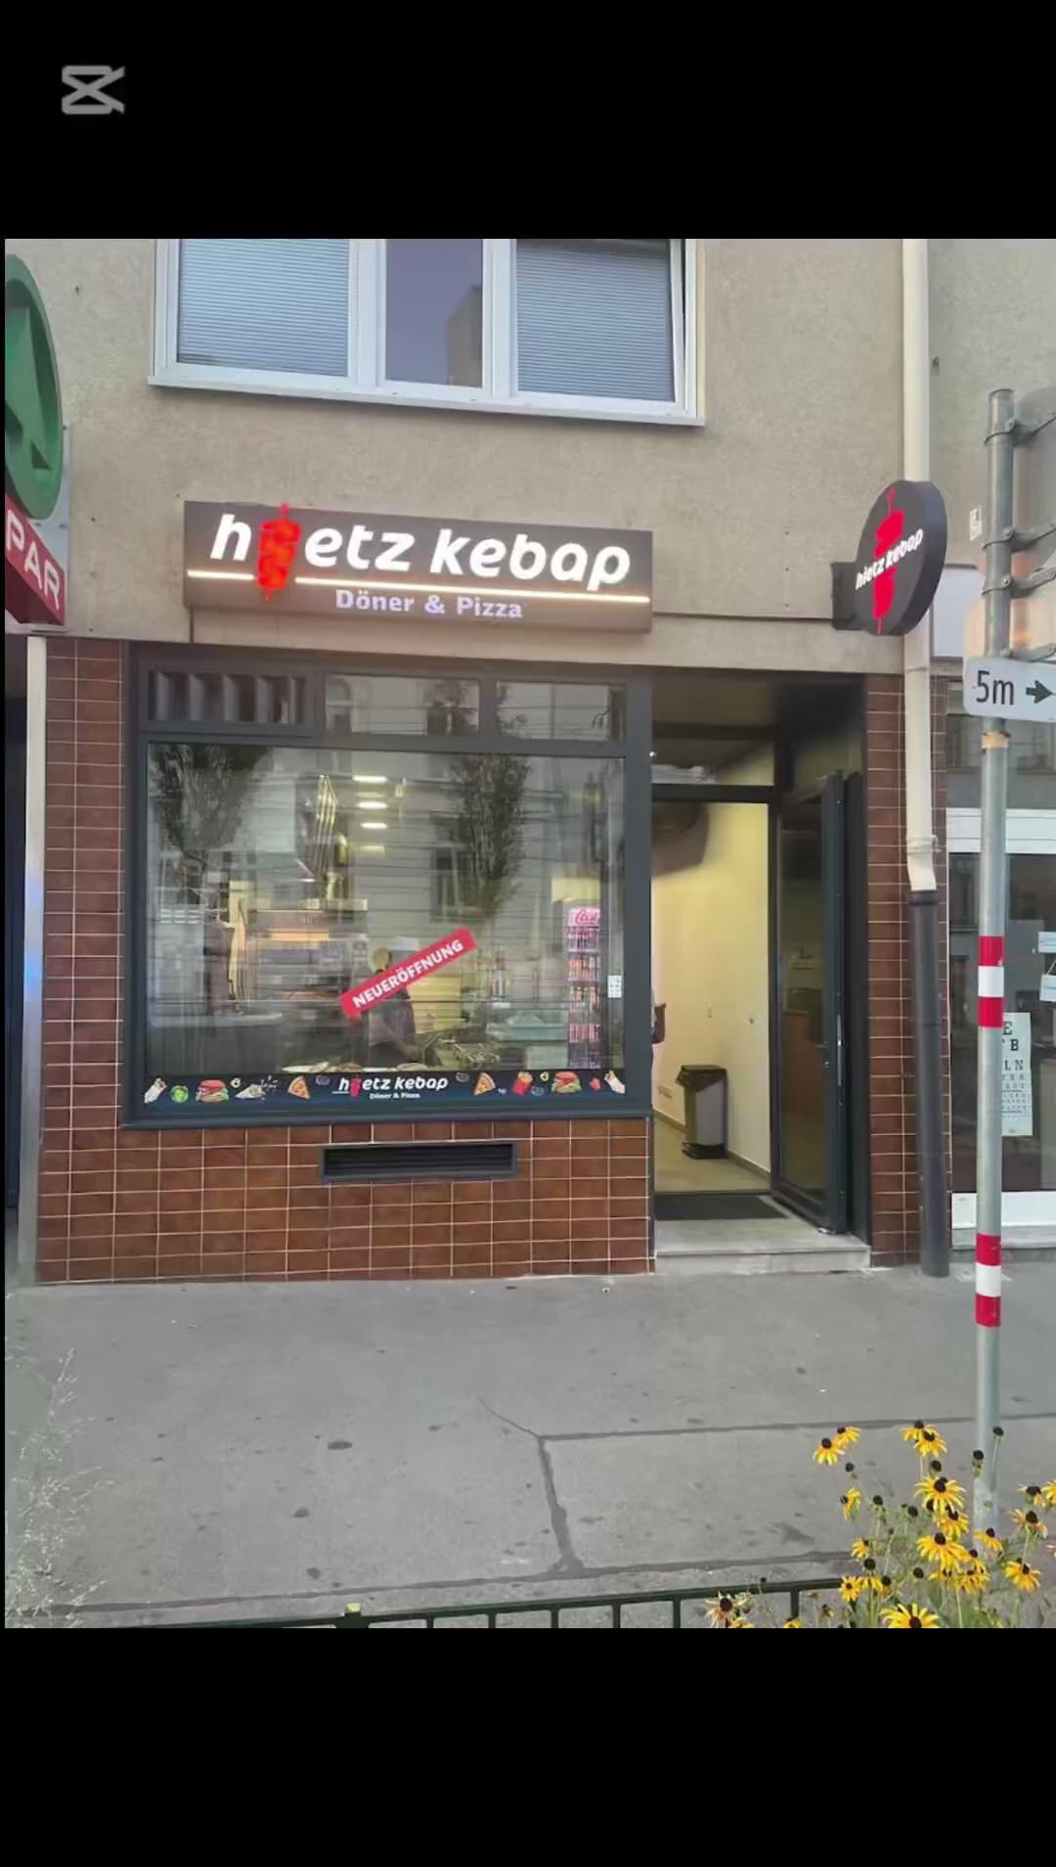
Video #12
Hietz Kebap

Slide 16

Video #13
Jin’s

